Slide 1
Rust – Vector & Tuple
Week 8

Slide 2
Rust - Vector
A vector is a container that stores the values like an array, but it has more advantages than an array data structure.
It can increase in size dynamically during runtime.
It is provided by the standard library that can store the value of any data type.
Its length defines the number of elements present in the vector.
Its capacity defines the actual allocated space on the heap of this vector.

Slide 3
Creating a vector in Rust:
Using Vec::new() Method
Using macro in Rust:

Slide 4
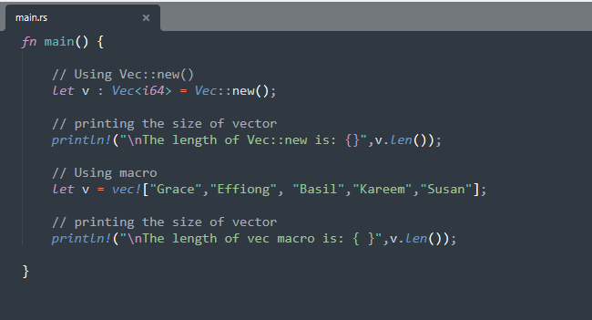
Creating a vector in Rust
Practice 1: week-8/practice_1/src/main.rs

Slide 5
Accessing a vector in Rust:
Using subscript operator
Using the get() method
Iterating on the vector

Slide 6
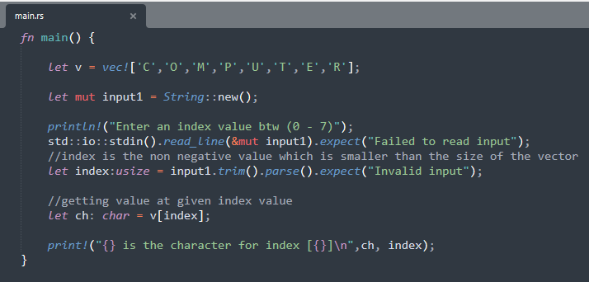
Using subscript operator
Similar to the concept of indexing in other languages, subscript operators can be used to directly access the values in a vector through their index.
Practice 2: week-8/practice_2/src/main.rs

Slide 7
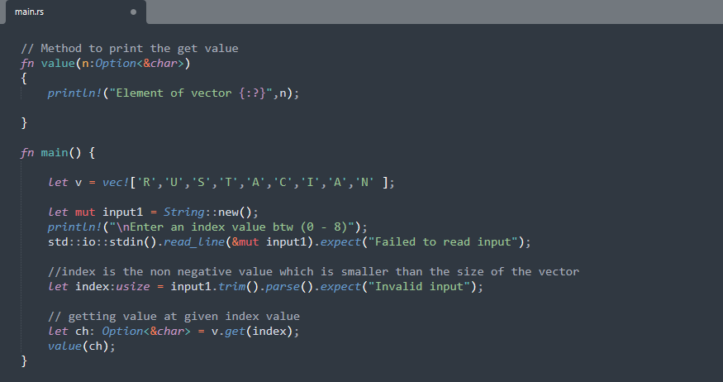
Using get() method
The second way of accessing the vector elements is to use the get(index) method with the index of a vector passed as an argument.
Practice 3: week-8/practice_3/src/main.rs

Slide 8
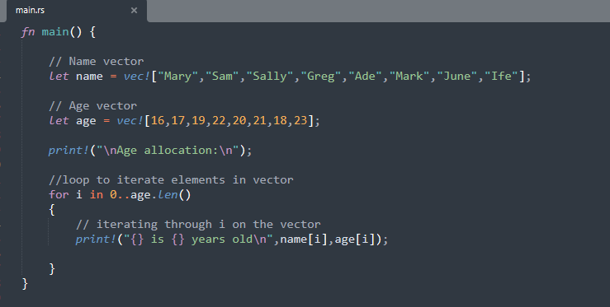
Iterating on the vector
To access the vector we can also iterate through a vector-like we do in arrays. We can use for loop to iterate through a vector.
Practice 4: week-8/practice_4/src/main.rs

Slide 9
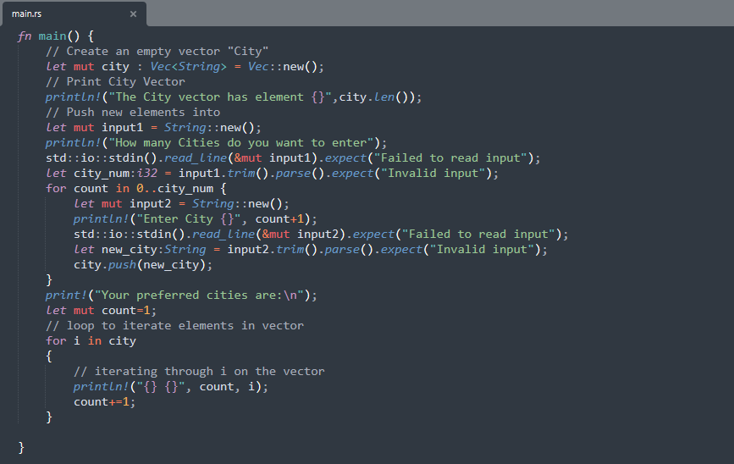
Updating a vector
Practice 5: week-8/practice_5/src/main.rs

Slide 10
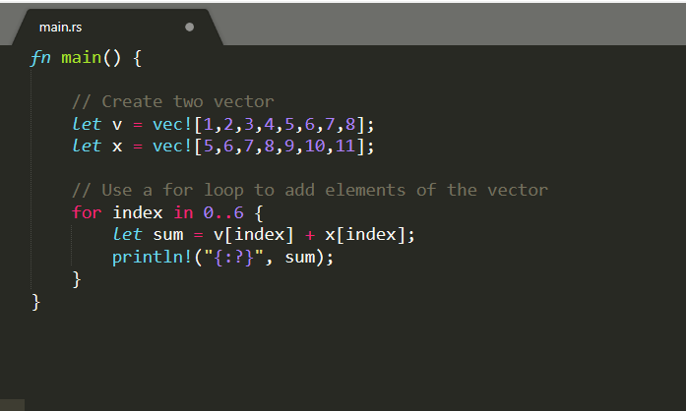
Adding two vectors
Practice 6: week-8/practice_6/src/main.rs

Slide 11
Rust Tuple
Tuple is a compound data type. A scalar type can store only one type of data. For example, an i32 variable can store only a single integer value.
In compound types, we can store more than one value at a time and it can be of different types.
Tuples have a fixed length - once declared they cannot grow or shrink in size. The tuple index starts from 0.
The println!("{ }") syntax cannot be used to display values in a tuple. This is because a tuple is a compound type. Use the println!("{:?}") syntax to print values in a tuple.

Slide 12
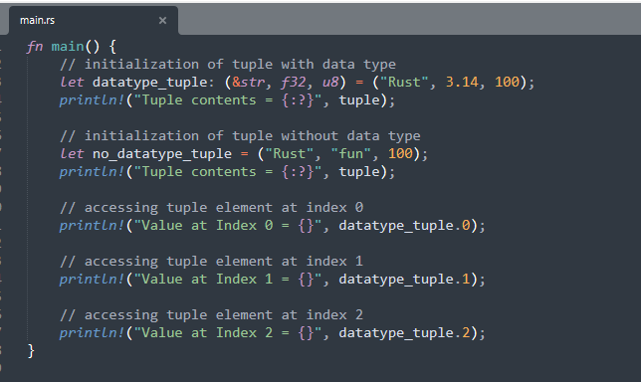
Initializing & Accessing Elements
Practice 7: week-8/practice_7/src/main.rs

Slide 13
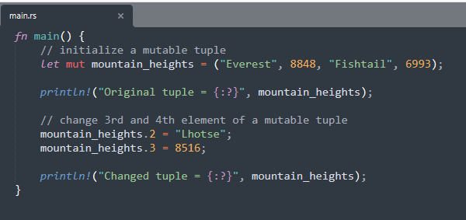
Mutable Tuple
In Rust, a tuple is immutable, which means we cannot change its elements once it is created. However, we can create a mutable tuple by using the mut keyword before assigning it to a variable.
Practice 8: week-8/practice_8/src/main.rs

Slide 14
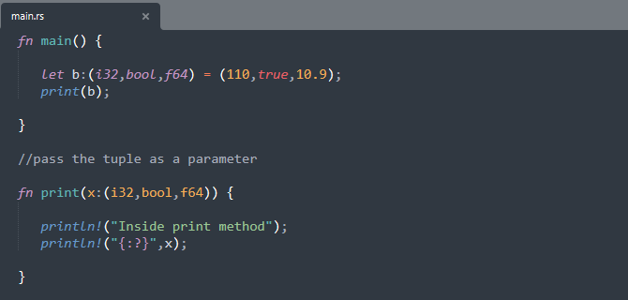
Passing a Tuple as parameter
A tuple can be passed by value to functions
Practice 9: week-8/practice_9/src/main.rs

Slide 15
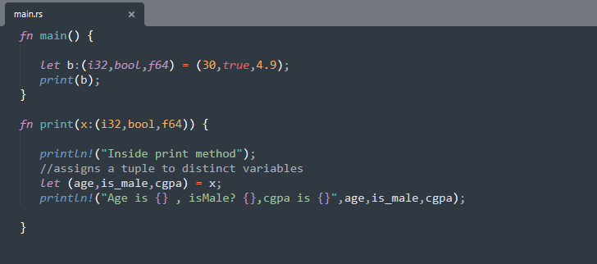
Destructuring a Tuple
We can break down tuples into smaller variables in Rust, known as destructuring.
Practice 10: week-8/practice_10/src/main.rs

Slide 16
Rust Slice
A slice is a pointer to a block of memory.
Slices can be used to access portions of data stored in contiguous memory blocks.
It can be used with data structures like arrays, vectors and strings.
Slices use index numbers to access portions of data. The size of a slice is determined at runtime.
Slices are pointers to the actual data. They are passed by reference to functions, which is also known as borrowing.

Slide 17
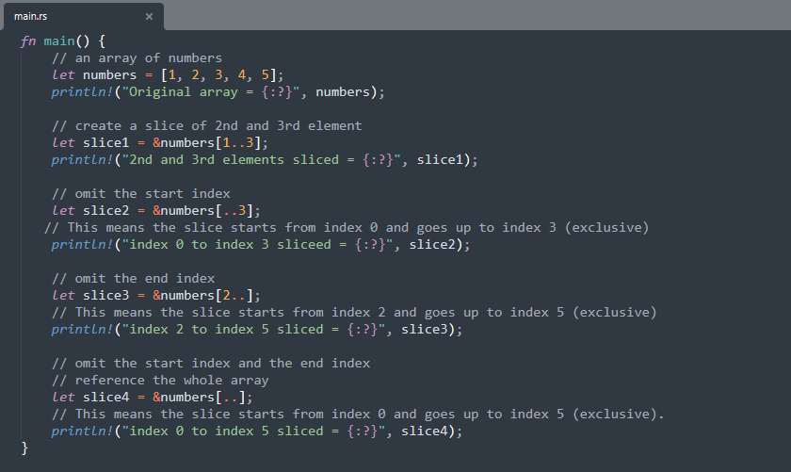
Rust Slice
Practice 11: week-8/practice_11/src/main.rs

Slide 18
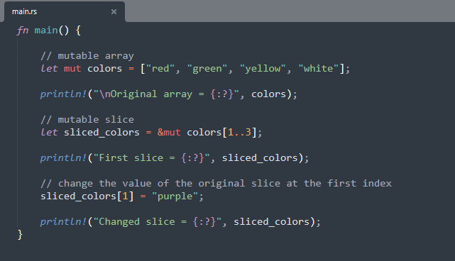
Mutable Slice in Rust
Practice 12: week-8/practice_12/src/main.rs

Slide 19
Class Projects

Slide 20
Class Project I
You have been invited to join the team of developers to build a Public Service APS level checker for the Federal Government of Nigeria. You have been provided the following table below.
Develop a Rust program using vectors to validate Staff level. E.g. If Staff is an Associate Lawyer, and has 5-8 years of work experience, then the staff holds position APS 5-8.
Public Servant | Office Administrator | Academic | Lawyer | Teacher
APS 1-2 | Intern | – | Paralegal | Placement
APS 3-5 | Administrator | Research Assistant | Junior Associate | Classroom Teacher
APS 5-8 | Senior Administrator | PhD Candidate | Associate | Snr Teacher
EL1 8-10 | Office Manager | Post-Doc Researcher | Senior Associate 1-2 | Leading Teacher
EL2 10-13 | Director | Senior Lecturer | Senior Associate 3-4 | Deputy Principal
SES | CEO | Dean | Partner | Principal

Slide 21
Class Project II
Ernst & Young (EY) Global Limited, is a multinational professional services network with headquarters in London and branch offices all around the world. EY is one of the largest professional services networks in the world. EY Nigeria recently launched a project and are scouting for developers with the highest years of experience. You have been contacted by the CEO of EY Nigeria to develop a Rust program to find the person with the highest years of programming experience during the job interview using any rust compound data type.

